Slide 1

Compiler Design
Preet Kanwal
Department of Computer Science & Engineering
Teaching Assistant : Kavya P K

Slide 2

Compiler Design Lecture Overview
In this lecture, you will learn about:
The Lexical Analyser
Role of a lexer
The need to separate Lexical Analyser and Parser and the interaction between them
Challenge of Lexical Analyser - Speed
Input Buffer
Buffer Pairs
Buffer Pair Algorithm
Sentinels
Lexical Errors

Slide 3
Compiler Design
Unit 1
Lexical Analysis
Preet Kanwal
Department of Computer Science & Engineering

Slide 4
Compiler Design
Some important definitions
Token :- It is a pair consisting of a token name and an optional attribute value.
<token name, attribute value>
Token name is an abstract symbol representing a kind of lexical unit - keywords, identifiers etc.
Attribute value is pointer to the symbol table entry.
Pattern :- It is a description of the form that the Lexemes of a token may take.
Keyword - a sequence of characters
Identifiers - sequence of character with some complex Structure
Lexeme :- It is a sequence of characters in the source program that matches the pattern for a token, i.e, and instance of a token

Slide 5
Compiler Design Examples
Token | Informal Description of Pattern | Lexemes
if | Character i,f | if
else | Characters e,l,s,e | else
Comparison | < or > or <= or >= or == or != | <=,!=
id | Letter followed by letters and digits | Sum, avg1, pi
number | Any numeric constant | 10001, 3.14
literal | Anything but “, surrounded by “ | “compiler design”

Slide 6
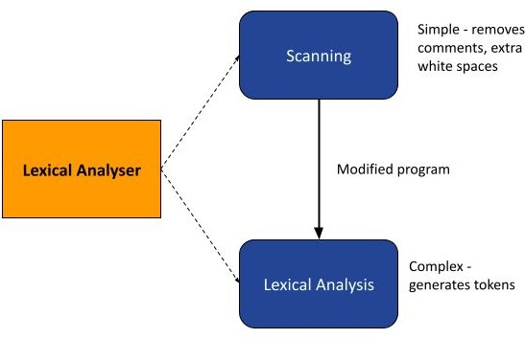
Compiler Design
Introduction to Lexical Analyzer
The Lexical Analyzer is the first phase of the compiler.
It is language dependent.
It performs two main tasks -
Scanning
Reading the input characters of the source program.
Performing simple processes that do not require tokenization of the
input deletion of
comments, consecutive
compaction of whitespaces.
2. Lexical Analysis - Producing the sequence of tokens as output.

Slide 7
Compiler Design
Goal of a Lexical Analyzer
To convert from physical description of a program into sequence of of tokens.
Each token represents one logical piece of the source file - a keyword, the name of a variable etc.
Each token is associated with a lexeme, i.e, the actual text of the token: ”137,” ”int,” etc.
Each token can have optional attributes - Extra information derived from the text, perhaps a numeric value.
The token sequence will be used in the parser to recover the program structure.

Slide 8
Compiler Design Role of a lexer (1)
The Lexical analyzer reads the input characters of the source program and then performs the following steps:
Groups the input characters into Lexemes.
Produces a sequence of tokens for each lexeme in the source program as output.
Sends the stream of tokens to the parser for Syntax Analysis.
When a lexeme representing an identifier is discovered, it is entered into the symbol table.

Slide 9
Compiler Design Role of a Lexer (2)
The Lexical Analyzer also performs the following secondary tasks:
Stripping out comments and white space like blank, new line, tab and other characters that are used to separate tokens in the input.
Correlating error messages generated by the compiler with the source program file.
Keeping track of the number of the newline characters and associate each error message with its line number.
Make a copy of the source program with error messages inserted at appropriate positions.
Expansion of macros

Slide 10
Compiler Design
The need to separate Lexical Analyzer and Parser
There exists a tight coupling between lexical analyzer and Parser.
The Parser works as the master program, and directs the lexical analyzer.
However, there are several reasons to separate lexical analyzer and syntax analysis into different phases -
Simplicity of design
Comments and spaces are removed in the lexical analysis phase.
If performed by the parser, parser design becomes very complex.
Separating lexical and syntactical concerns leads to cleaner design.
Compiler efficiency is improved - specialised buffering schemes can be used for reading characters, which can speed up the compiler.
Compiler portability is enhanced - input specific peculiarities can be restricted to the lexical analyzer.

Slide 11
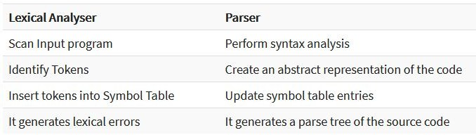
Compiler Design
Lexical Analyzer Versus Parser

Slide 12
Compiler Design
Interaction Between the Lexical Analyzer and Parser(1)
Error Handler
read (2)
Lexer /
getNextToken (1)
Input File / Source code
Parser / Syntax Analyzer
To semantic
Analysis
Scanner /
Lexical Analyzer
lexeme (3)
Token (4)
Regex
Symbol Table
Grammar

Slide 13
Compiler Design
Interaction Between the Lexical Analyzer and Parser (2)
Lexer stops when parser stops since the parser is its master.
If working only with the lexer, then the lexer must be explicitly stopped rest it will continue running infinitely.
Comments are eliminated by the preprocessor but even the compiler can remove comments in the lexer phase. If “-E” is used in the gcc command, then comments are not removed in the preprocessing phase. So, the lexer can make sure that comments do not reach the parser.

Slide 14
Compiler Design
Challenge: Speed of Lexical Analyzer
The lexical analyzer reads characters of the source program one at a time to discover tokens.
Thus, speed of lexical analysis is a concern.
In many languages, there are scenarios when the lexer needs to look ahead at least one character before a match can be announced.
Solution - The lexical analyzer reads from Input Buffers
There are many schemes that can be used to buffer input. This course discusses two schemes -
Buffer Pairs
Sentinels

Slide 15
Compiler Design
Input Buffers - Buffer Pairs
This scheme makes use of two buffers of the same size(N).
Usually, N = size of disk block = 4096 bytes.
These buffers are alternately reloaded.
A single system read can be used to read N characters into the buffer instead of one system call per character.
If fewer than N characters remain in the input file, EOF is read into the buffer, marking the end of the source file.

Slide 16
Compiler Design
Input Buffers - Buffer Pairs
Two pointers are maintained to the input buffer -
lexeme_begin - marks the beginning of the current lexeme
forward - scans ahead till a pattern is found.
Initially, both pointers point to the first character of the next lexeme to be found.
The forward pointer scans ahead until a match for the pattern is found.
The string of characters between the two pointers is the current lexeme.
Once the lexeme is determined, the forward pointer is set to the character at the right end of the lexeme.
After the lexeme is processed, both pointers are set to the character immediately after the lexeme.

Slide 17
Compiler Design
Input Buffering - Buffer Pairs Algorithm
if forward at end of first half then begin
reload second half;
forward := forward +1
end
else if forward at end of second half then begin
reload first half;
move forward to beginning of first half
end else
forword := forward + 1;

Slide 18
Compiler Design
Input Buffering - Buffer Pairs Example
Consider the following statement - abc = pqr * xyz ;

Slide 19
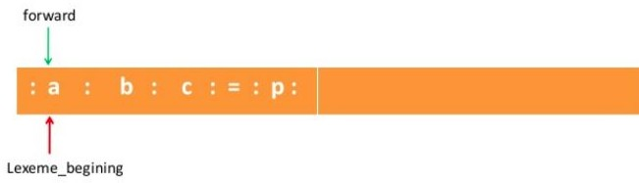
Compiler Design
Input Buffering - Buffer Pairs Example
abc = pqr * xyz ;
Initially, both pointers are set to the beginning of the buffer.

Slide 20
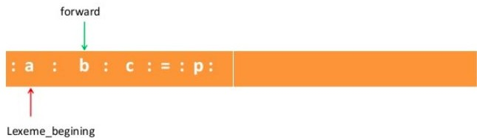
Compiler Design
Input Buffering - Buffer Pairs Example
abc = pqr * xyz ;
Forward pointer advances till a pattern is matched.

Slide 21
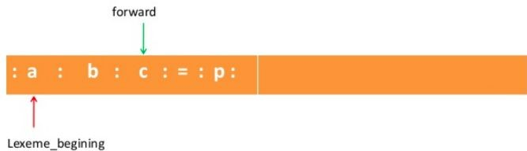
Compiler Design
Input Buffering - Buffer Pairs Example
abc = pqr * xyz ;
Forward pointer advances till a pattern is matched.

Slide 22
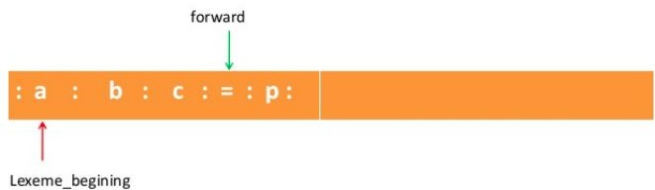
Compiler Design
Input Buffering - Buffer Pairs Example
abc = pqr * xyz ;
Here, a pattern is matched. The current lexeme lies between the two pointers.
Current lexeme: abc

Slide 23

Compiler Design
Input Buffering - Buffer Pairs Example
abc = pqr * xyz ;
Both forward and lexeme_begin are set to the next character after the lexeme.

Slide 24

Compiler Design
Input Buffering - Buffer Pairs Example
abc = pqr * xyz ;
The current lexeme is =
Both forward and lexeme_begin are moved to the next character after the current lexeme.

Slide 25

Compiler Design
Input Buffering - Buffer Pairs Example
abc = pqr * xyz ;
The forward pointer has reached the end of the first buffer.

Slide 26
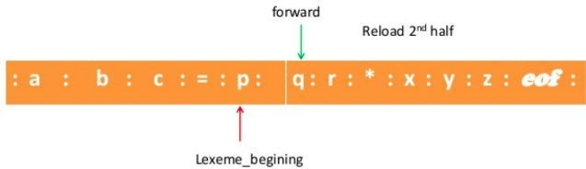
Compiler Design
Input Buffering - Buffer Pairs Example
abc = pqr * xyz ;
The second input buffer is reloaded. Forward pointer moves ahead till the next pattern is matched.
This process continues till EOF is reached.

Slide 27
Compiler Design Drawbacks of Buffer Pairs
The drawbacks of the buffer pairs algorithm is that each time we advance forward, there are two checks that need to be performed -
For End Of Buffer
To determine which character is read
Solution - Combine the buffer-end check with the check for current character.
This can be done by extending each buffer to hold a Sentinel character (EOF) at the end.

Slide 28
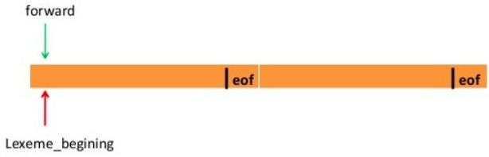
Compiler Design
Input Buffering : Buffer pairs with Sentinels
Sentinels (eof) are added to the end of each input buffer.

Slide 29
Compiler Design
Input Buffering - Buffer pair Algorithm (with sentinels)
forward = forward + 1;
if forward = eof then begin
if forward at end of first half then begin
reload second half;
forward := forward +1
end
else if forward at end of second half then begin
reload first half;
move forward to beginning of first half
end else
terminate lexical analysis
/* eof within buffer, i.e, end of input */
end

Slide 30
Compiler Design Lexical Errors
Suppose a situation arises in which the lexical analyzer is unable to proceed because none of the patterns for tokens matches any prefix of the remaining input.
Some possible scenarios are -
Spelling Error
Unmatched string
Appearance of illegal characters
Exceeding length of identifiers

Slide 31
Compiler Design Lexical Errors
Spelling Error
Unmatched string
Appearance of illegal characters
Exceeding length of identifiers
di{…
…………………} while();

Slide 32
Compiler Design Lexical Errors
Spelling Error
Unmatched string
Appearance of illegal characters
Exceeding length of identifiers
printf(“hi);
printf(“hi”);

Slide 33
Compiler Design Lexical Errors
Spelling Error
Unmatched string
Appearance of illegal characters
Exceeding length of identifiers
printf(“hi”)$$;

Slide 34
Compiler Design Lexical Errors
Spelling Error
Unmatched string
Appearance of illegal characters
Exceeding length of identifiers
More than 32 characters in an identifier

Slide 35
Compiler Design Error Message
When writing an error message, make sure it satisfies the following properties:
It must pinpoint the error correctly
It must be understandable
It must be specific
It must not have any redundancy

Slide 36
THANK YOU
Preet Kanwal
Department of Computer Science & Engineering
preetkanwal@pes.edu

